Slide 1
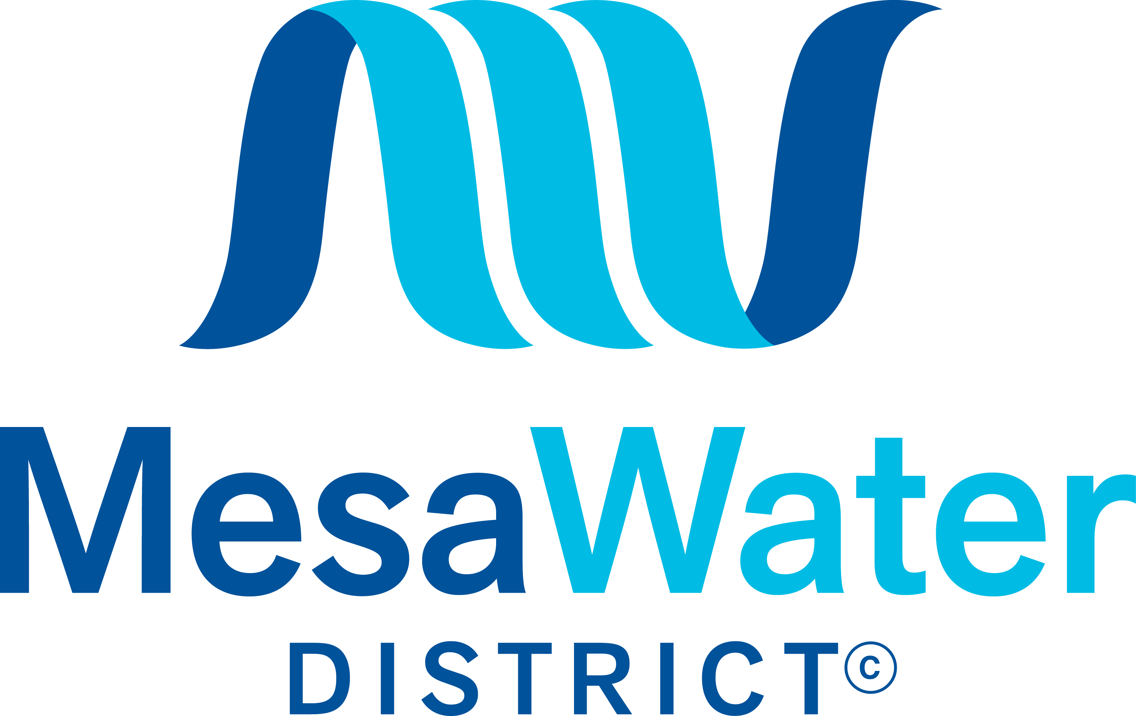

2019 Water Cost
Comparison Study
Webinar
May 13, 2021

Slide 2
Objective of the study
To develop a water cost comparison analysis with the intent of identifying a feasible methodology for measuring the operational efficiency of Water Districts within Orange County

Slide 3
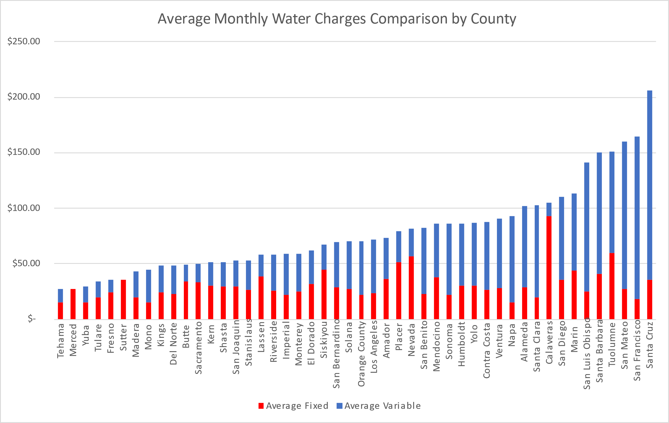
Water rates comparison
2019

Slide 4
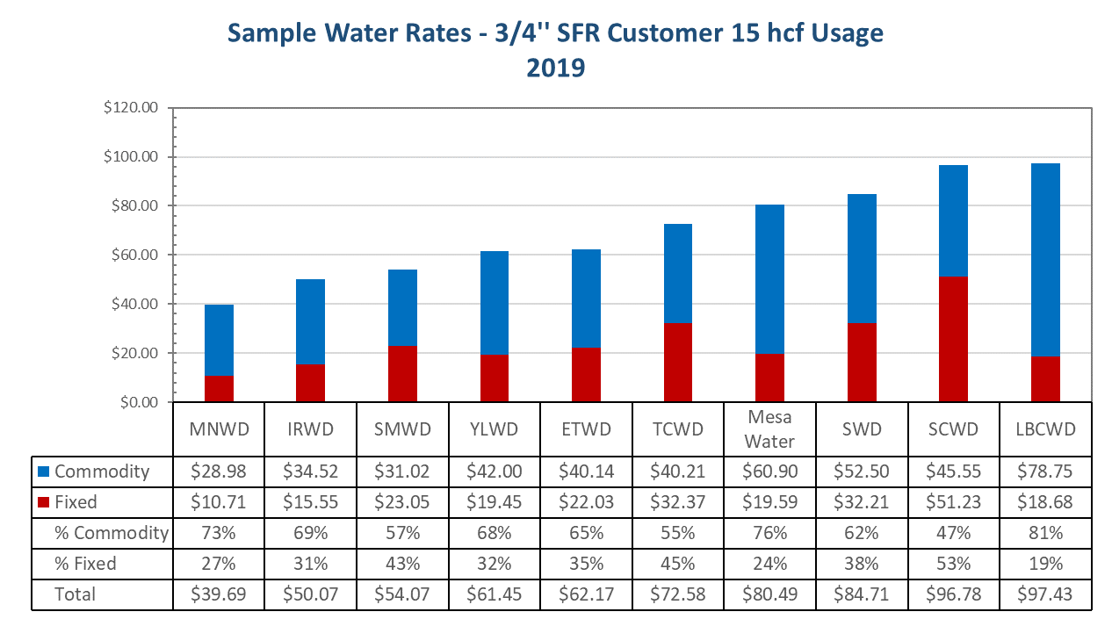
Sample water rates comparison
2019
Data Source: Raftelis Rate Survey 2019

Slide 5
Using water rates to measure operational efficiency
Challenges:
  Size of agency, geographic location, overall demand, etc.
  Non Rate Revenues
    Many agencies receive non-rate revenues, i.e. property tax, which offset water costs and affects water rates
  Data change
    California State Controller Office made changes in data format for special districts in 2019. The data in this survey includes data from both SCO’s databases (2003-2018) and 2019

Slide 6
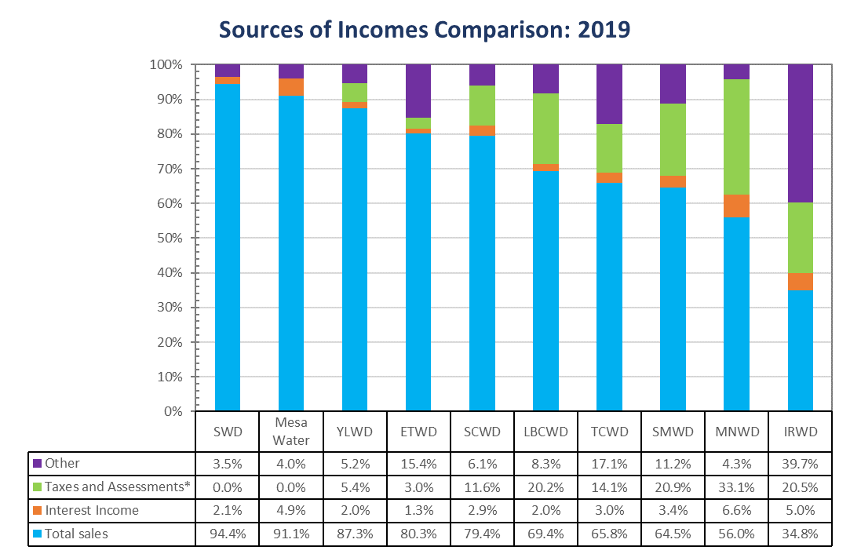
Sources of income
2019
Data Source: California State Controller's Office, Special Districts Financial data for 2019
Notes:
The structure of Income is based on SCO’s data:
Revenues from Taxes and Assessments currently include :
Current Secured and Unsecured (1%) - Report both the secured and unsecured property taxes apportioned by the county from the 1% Tax Rate including the supplemental tax roll.. Do not include Homeowner's Property Tax Relief; instead report that amount in State: Homeowner's Property Tax Relief reporting category.
Voter-Approved Taxes - Report the ad valorem property taxes received levied in excess of the 1% tax rate.
Property Assessments - Report assessments made against properties in the district on a non-ad valorem basis. Assessment basis can be per parcel, acre, or other per unit basis.
Prior Year Taxes and Assessments - Report prior year taxes, assessments, and penalties including the supplemental tax roll.
Penalties and Costs
MNWD Other income includes so called Special Assessments (assessments made for the pay-off of bonds related to the Mello-Roos and Mark-Roos Bond acts) and Other Intergovernmental - Federal (other aid, including operating support grants, from the federal government other than aid for construction)
IRWD Other income includes so called Service Type Assessments (those are service type assessments other than standby and availability charges which are used for operating purposes and are levied against properties in the district on a per unit/acre/parcel etc. basis.)
SMWD Taxes and Assessments revenue currently includes Voter Approved Taxes, that we guess may not have been included in the MWDOC survey under the property tax revenue.

Slide 7
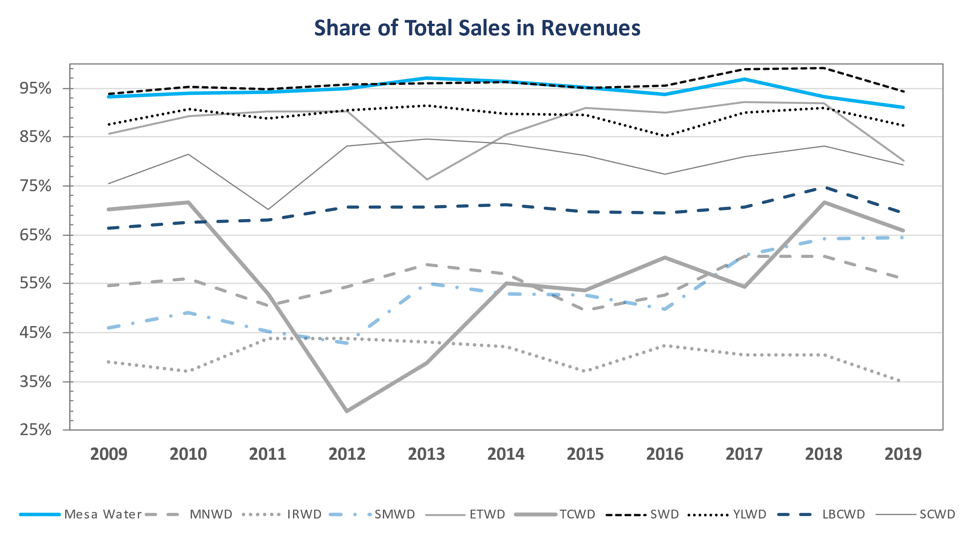
Share of sales in total revenues 2009-2019
Data Source: California State Controller's Office, Special Districts Financial data;
This graph uses California State Controller office’s database for 2003-2018 and database for 2019
Notes:
NOTE: SCO changed the dataset structure in 2017. For this graph we use two datasets: 2003-2016 and 2017
TCWD – special assessment revenue in 2012/2013/2014 : payments of bonds related to Mello-Roose and Mark-Roose bond acts
TCWD – 2015 – property assessment increase
ETWD – “another revenue” increase in 2013

Slide 8
Total expenditure per capita
Total Expenditure Per Capita:
Proxy to Measure Efficiency
  Total expenditures for special districts are gathered by the CA State Controller’s Special Districts Annual Report
  Population service area is available from the last MWDOC and 2015 Urban Water Management Plan by Water District
Notes:
The data for 2017 is based on SCO’s Special Districts Financial Database for 2017.
The Municipal Water District of Orange County decided to discontinue the Orange County Supplier survey.
The latest survey included data of Aug 2013 and the water district population data was not updated from 2012.
However, as the population change is very slow process, we assumed that using 2012 population data would not affect the results significantly.

Slide 9
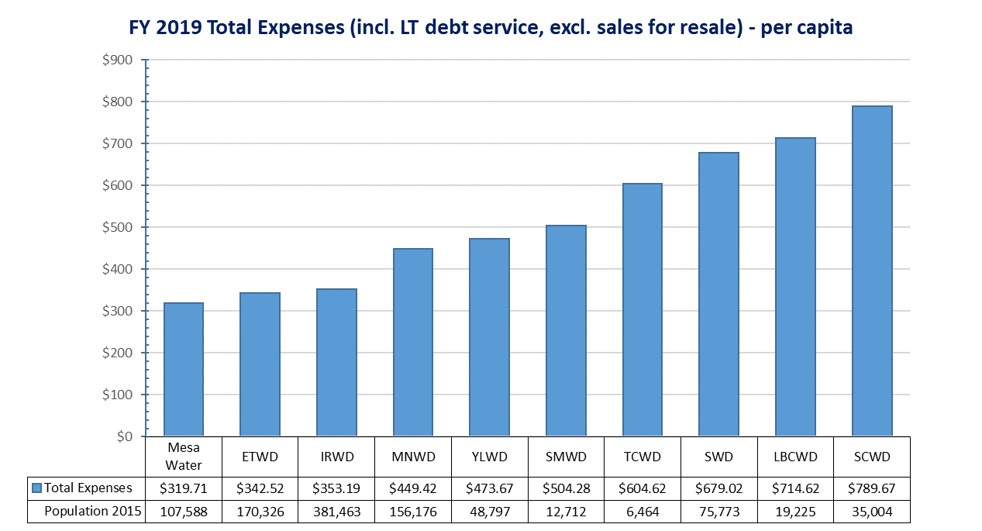
Expenditure comparison per capita
2019
Data Sources:
California State Controller's Office, Special Districts Financial Data for total costs and long-term debt
Population from Orange County Water Suppliers - respective agencies’ 2015 UWMP

Slide 10
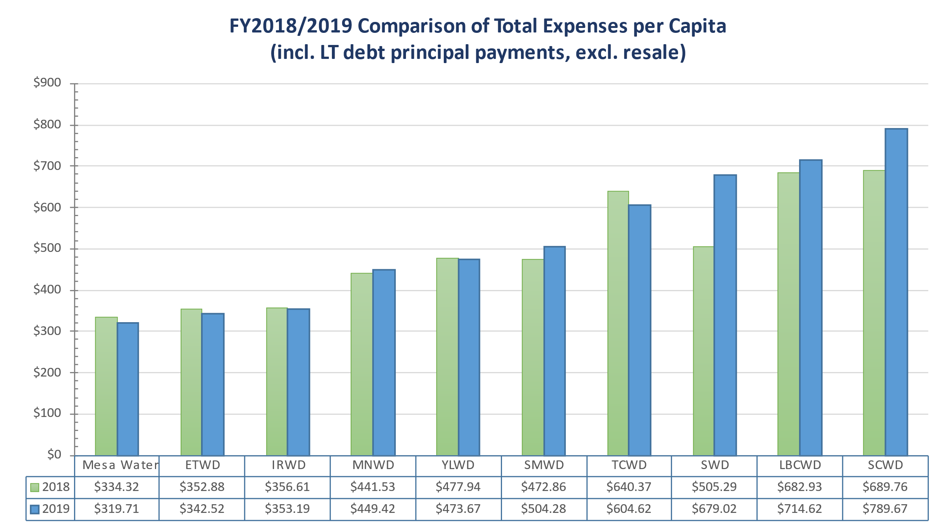
Expenditure comparison per capita
2018 / 2019
Data Sources:
California State Controller's Office, Special Districts Financial Data for total costs and long-term debt
Population from Orange County Water Suppliers - respective agencies’ 2015 UWMP

Slide 11
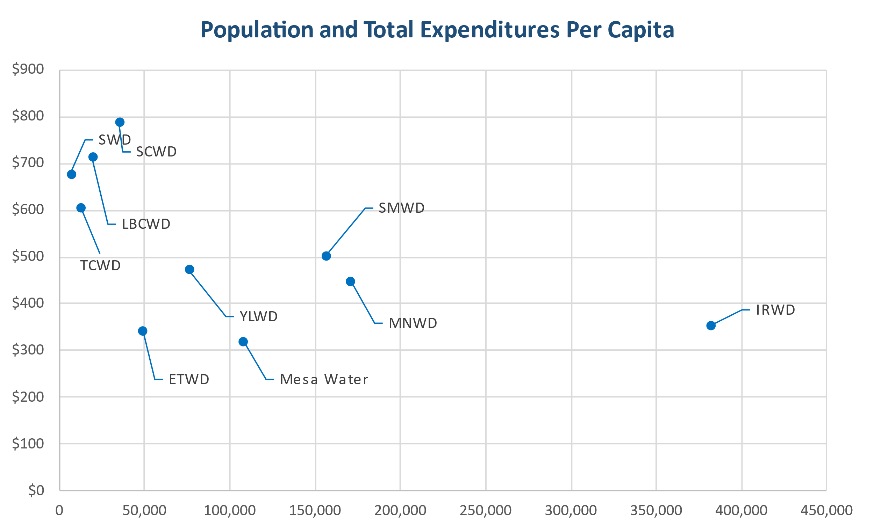
Population and total expenditure
2019
Data Sources:
California State Controller's Office, Special Districts Financial Data for 2019
Population from Orange County Water Suppliers - respective agencies’ 2015 UWMP

Slide 12
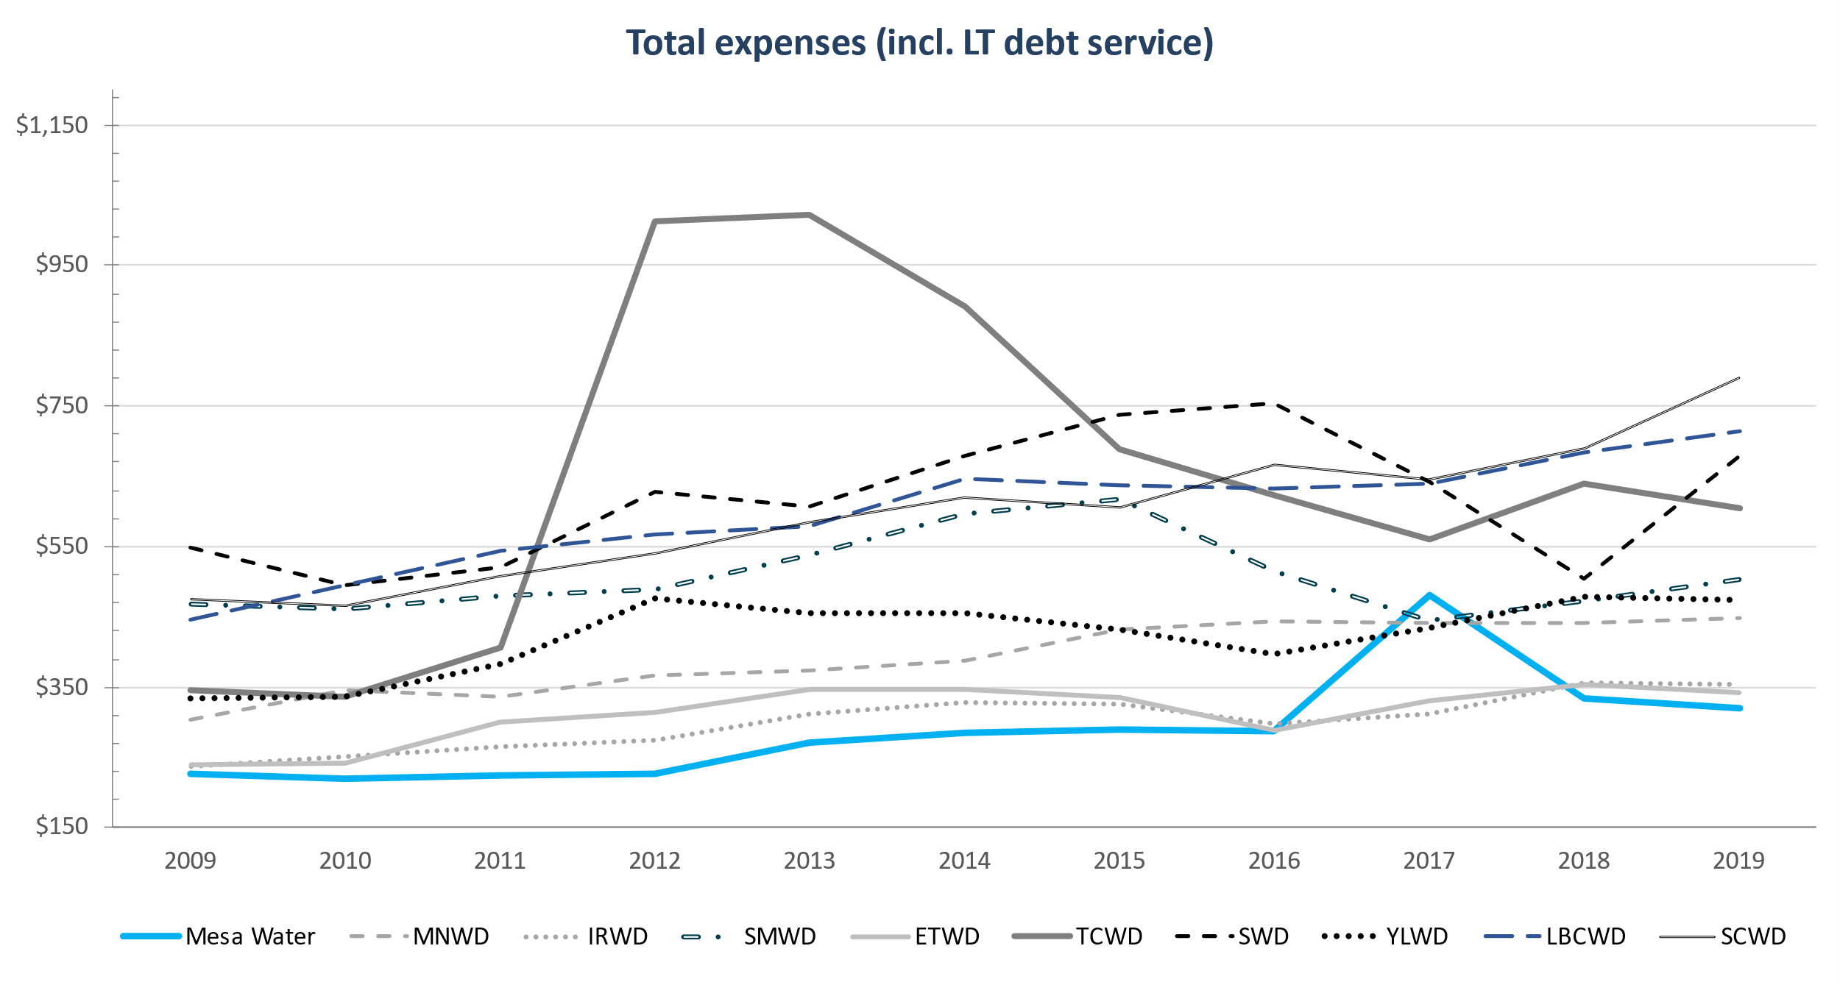
Total expenditures per capita 2009-2019
2009 - 2019 | MNWD | IRWD | SMWD | ETWD | TCWD | SWD | YLWD | LBCWD | SCWD | Mesa Water
% change | 48% | 49% | 8% | 43% | 75% | 24% | 41% | 60% | 66% | 40%
$ change | $145 | $116 | $37 | $102 | $259 | $129 | $139 | $268 | $315 | $92
Data Sources:
California State Controller's Office, Special Districts Financial Data for 2003 -2018 and for 2019
Population: see end slide for details
Notes:
The spikes represent principal amount matured during the fiscal year.
Mesa WD 2008, 2017 - Principal amount matured during fiscal year
TCWD 2012, 2013, 2014 - Principal amount matured during fiscal year – corresponds to the increased revenues for Mello-Roose and Mark-Roose bond acts

Slide 13
The value of water and water conservation
Higher percentages of revenue from commodity rates are more likely to educate customers on the value of water and promote conservation

Slide 14
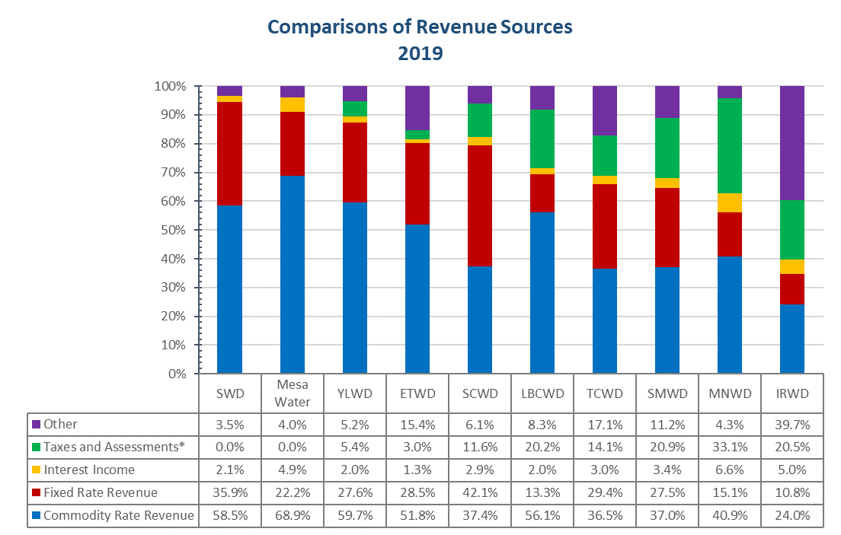
The value of water and water conservation
Data Sources:
California State Controller's Office, Special Districts Financial Data for 2019
Raftelis rate survey 2019

Slide 15
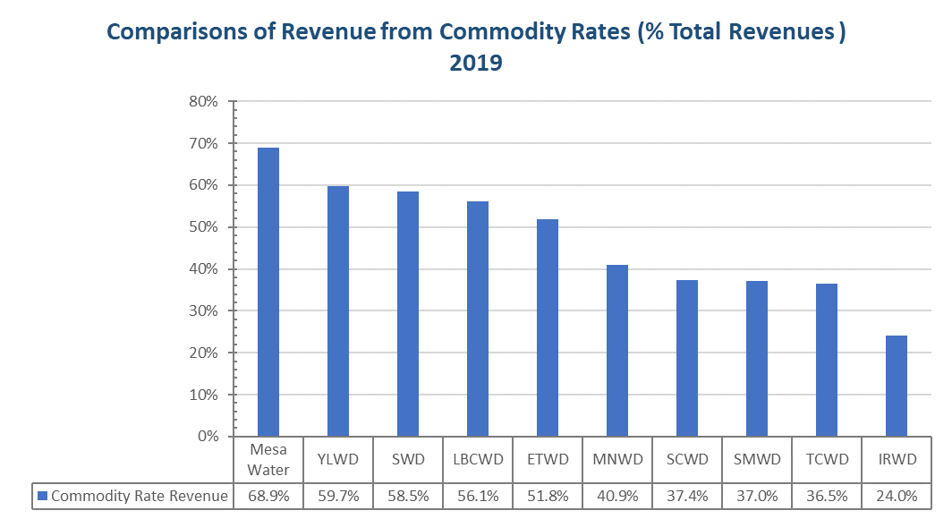
The value of water and water conservation
Data Sources:
California State Controller's Office, Special Districts Financial Data for 2019
Commodity/Fixed rate revenue shares – Raftelis Rate Survey 2019

Slide 16
Q&A

Slide 17
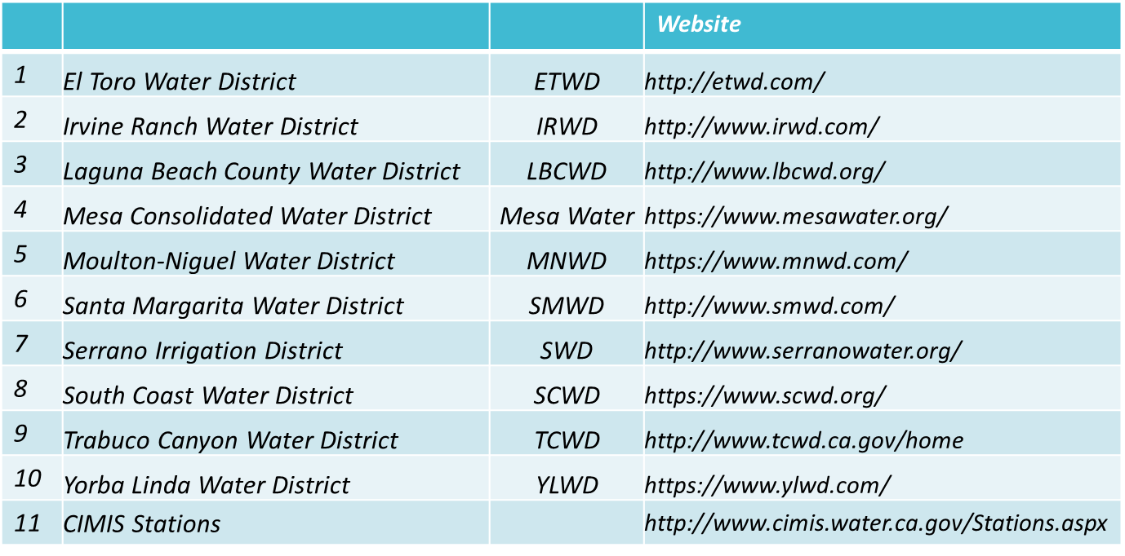
Raftelis’ Rate Survey Sources

Slide 18
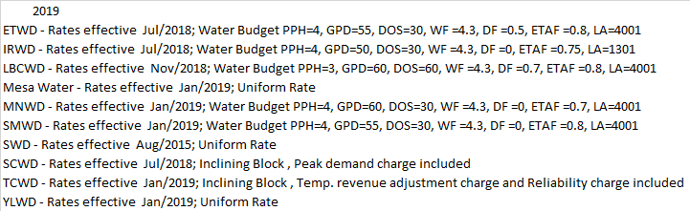
Raftelis’ Rate Survey Assumptions

Slide 19
Raftelis’ Population Survey
Water District | Population | Source
Mesa Water | 107,588 | UWMP - 2015
IRWD | 381,463 | UWMP - 2015
ETWD | 48,797 | UWMP - 2015
MNWD | 170,326 | UWMP - 2015
YLWD | 75,773 | UWMP - 2015
SWD | 6,464 | UWMP - 2015
LBCWD | 19,225 | UWMP - 2015
SCWD | 35,004 | UWMP – 2015
SMWD | 156,176 | CAFR - 2017
TCWD | 12,712 | UWMP - 2015

Slide 20
Data availability note and assumptions
MWDOC decided to discontinue the “Orange County Water Suppliers - Water Rates & Financial Information” (aka. MWDOC Rate Survey) which was used to provide data on rates structure (incl. fixed vs commodity rates) and on population served by the water districts.
This hinders our ability to precisely report Expenditure Per Capita figures.

